Slide 1


Traefik: Simplifying Traffic Management for Cloud-Native Applications
Hands-On Demo and Overview
Presented by: Prince Alben Uwizeye and Aditya
Notes:
1

Slide 2
Introduction to Traefik
What is Traefik?
Why Traefik?
Cloud-native reverse proxy & load balancer.
Automatic traffic routing.
Designed for containerized applications.
Handles HTTPS with Let's Encrypt.
Provides monitoring tools.
Notes:
2

Slide 3
Key Features of Traefik
Dynamic Service Discovery
Load Balancing
Automatic HTTPS
Distributes traffic across replicas.
Secures traffic with Let's Encrypt.
Auto-detects and configures services.
Middleware Support
Observability
Adds authentication, rate-limiting, etc.
Real-time dashboard, metrics, tracing.
Notes:
3

Slide 4
How Traefik Works
Core Components
Architecture
EntryPoints: traffic enters (HTTP, HTTPS)
Traefik listens to orchestrators (e.g., Docker, Kubernetes).
Routers: match requests to services
Routes traffic dynamically based on service discovery.
Services: backend applications
Middlewares: add features
Notes:
4

Slide 5
Real-Life Use Case: E-Commerce
Problem
Solution
Need to efficiently manage traffic for multiple microservices (product catalog, cart, payment).
Use Traefik for:
Dynamic routing to services based on subpaths (e.g., /catalog, /cart).
Load balancing between replicas.
Automatic HTTPS for secure transactions.
Notes:
5

Slide 6
The Demo Setup
Environment
What We Built
Docker-based setup with Traefik, static website, and API service.
Simple HTML website served by Nginx.
Node.js API returning JSON data.
Traefik routing traffic dynamically to both services.
Notes:
6

Slide 7
Demo Workflow
Traefik Configuration
1
Configured traefik.yml to manage HTTP & HTTPS traffic.
Website Setup
Enabled the dashboard for monitoring.
2
Created a simple static website hosted with Nginx.
API Setup
3
Built a Node.js API with Express returning JSON.
Dynamic Routing
4
Configured routes for website.localhost and api.localhost using Docker Compose labels.
Testing
5
Verified traffic routing using Traefik’s dashboard.
Notes:
7

Slide 8


Advanced Features
Load Balancing Strategies
Protocol Support
Round Robin, Weighted, Sticky Sessions.
HTTP/3, WebSocket, gRPC, TCP.
Middleware Capabilities
Observability Tools
Basic Authentication, Rate Limiting, URL Rewrites.
Dashboard, Prometheus/Grafana integration, OpenTelemetry.
Notes:
8

Slide 9

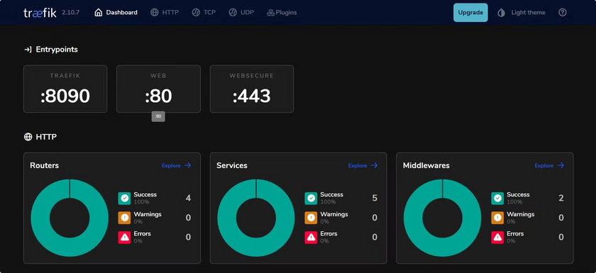
Summary
Simplifies traffic management for modern applications.
Key benefits
Dynamic routing & service discovery.
Automatic HTTPS with Let's Encrypt.
Built-in observability & scalability.
Ideal for Docker, Kubernetes, cloud-native environments.
Notes:
9

Slide 10

Thanks
Notes:
10

